Slide 1
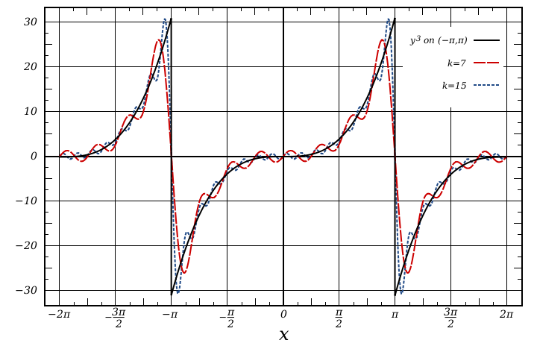
MAT 350 Engineering Mathematics
Fourier Series
and Fourier Transformation
Lecture: 10
Dr. M. Sahadet Hossain (Mth)
Associate Professor
Department of Mathematics and Physics, NSU.

Slide 2
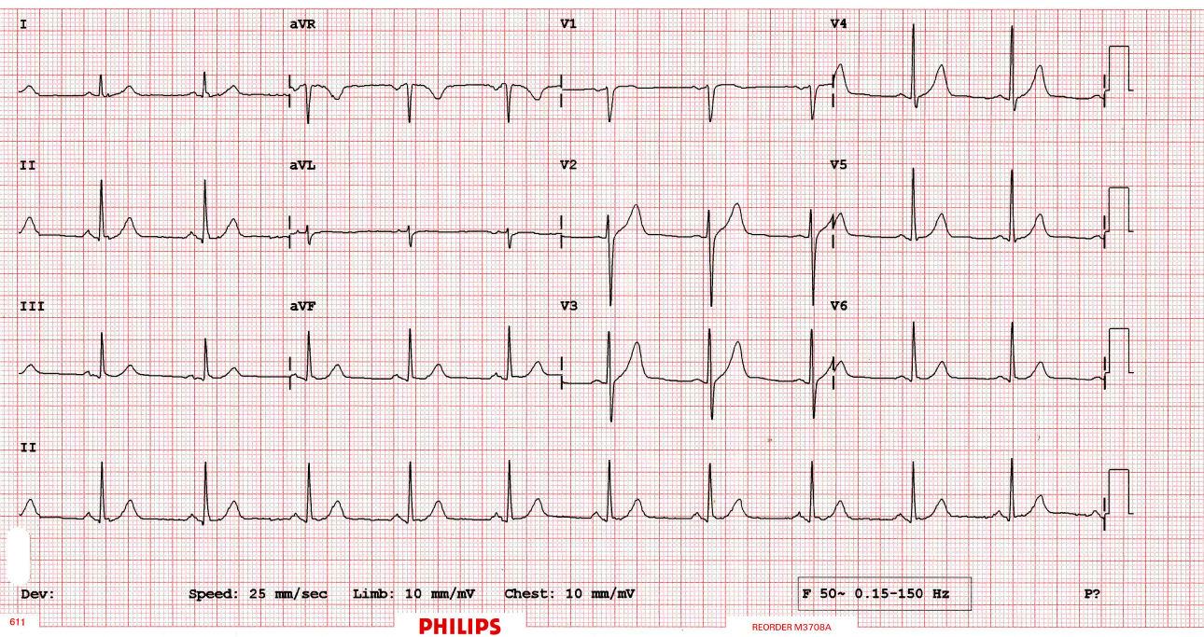
Introduction:
The central starting point of Fourier analysis is Fourier series. They are infinite series designed to represent general periodic functions in terms of simple ones, namely, cosines and sines.
In a digital age, the discrete Fourier transform plays an important role. Signals, such as voice or music, are sampled and analyzed for frequencies. An important algorithm, in
this context, is the fast Fourier transform.
https://www.intmath.com/blog/mathematics/math-of-ecgs-fourier-series-4281

Slide 3
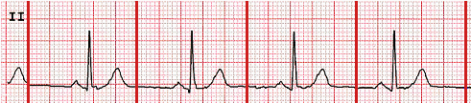
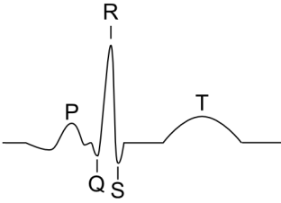
Modeling the Heartbeat Using Fourier Series
A heartbeat is roughly regular (if it isn't, it indicates something is wrong). Mathematically, we say something that repeats regularly is periodic.
Such waves can be represented using a Fourier Series.
Apparently (according to the doctor), this ECG indicates my heart is quite healthy

Slide 4
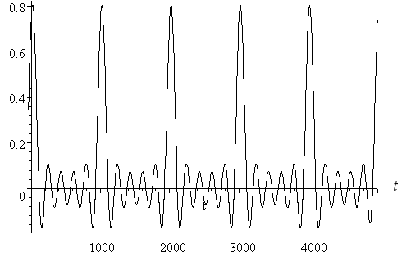
Modeling the Heartbeat Using Fourier Series
Assumptions
In my case, my heart rate was about 70 beats per minute. For the sake of simplicity, I'll assume 60 beats per minute or 1 per second. So the period = 1 second = 1000 milliseconds. A sample mathematical model ca be as follows:
f(t) = - 0.0000156(t − 20)⁴ + 2.5
f(t) = f(t + 1000)

Slide 5
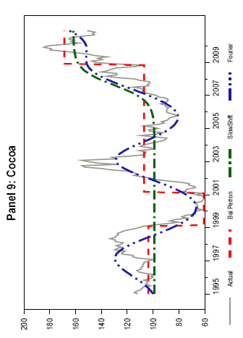
Modeling the behavior of real commodity prices over a finite period using Fourier Series
Approximation of Primary Commodity Prices
Figure: Commodity Prices, Actual Values and Shifting Means Obtained by Various Methods, 1995–2010

Slide 6

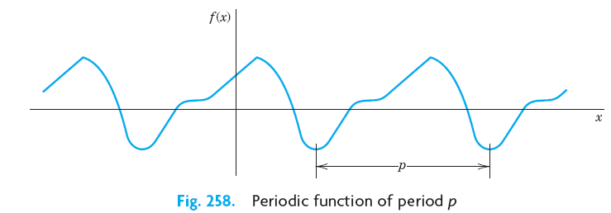
Fourier Series
Preliminaries:
A function f (x) is called a periodic function if f (x) is defined for all real x, except possibly at some points, and if there is some positive number p, called a period of f(x), such that
(1)
for all x.
(2)

Slide 7
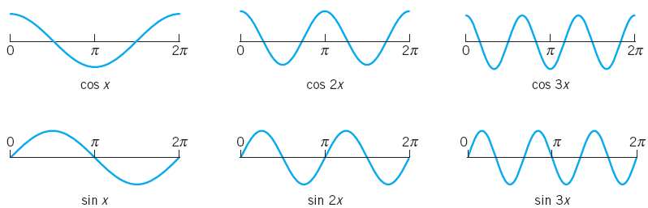
Periodic Function:
(2b)
All these functions have the period . They form the so-called trigonometric system.

Slide 8
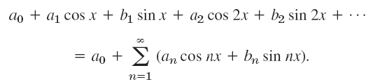
A trigonometric series is a combination of constant, sine, and cosine, as follows
(3)
We see that each term has the period 2π. Hence if the coefficients are such that the series converges, its sum will be a function of period 2π.

Slide 9

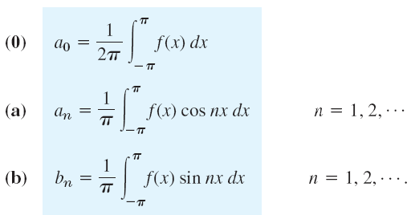
Now suppose that f(x) is a given function of period and is such that it can be represented by a series (3)
(4)
Equation (4) is called the Fourier series of f(x).
The coefficients of (4) are the so-called Fourier coefficients of f(x), given by the Euler formulas
(5)

Slide 10


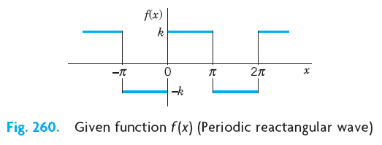
Periodic Wave Equation:
Find the Fourier coefficients of the periodic function
Class work

Slide 11
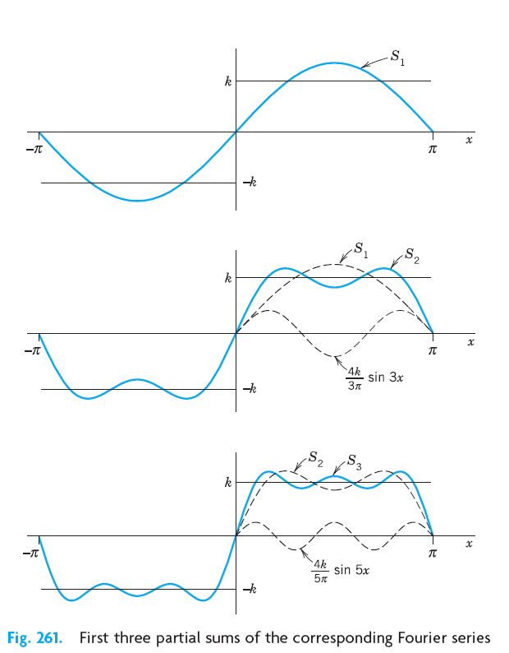

Slide 12
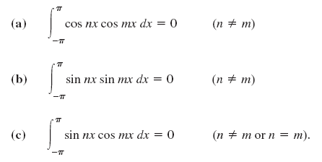
Derivation of Fourier coefficients by the Euler formulas
Theorem 1 :
The trigonometric system (2b) is orthogonal on the interval
(
,
that is, the integral of the product of any two functions in (2b) over that interval is 0, so that for any integers n and m,
(6)

Slide 13


Application of Theorem 1 to the Fourier Series:
We prove Eqn. 5(0).
Integrating on both sides of (4) from
5(0)

Slide 14
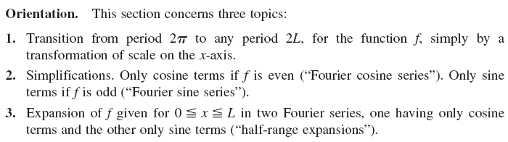
Chapter 11.2
Arbitrary Period. Even and Odd Functions.
Half-Range Expansions

Slide 15

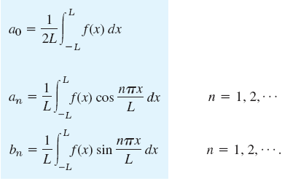
Fourier series for a function f(x), where the period is not 2π but 2L
(7)

Slide 16
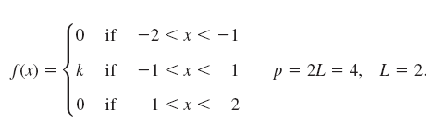
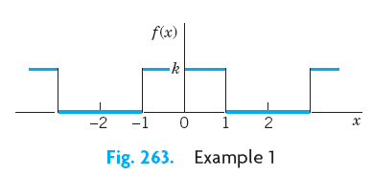

Slide 17





Using relation (7), we obtain
Using relation (7), we also obtain
Hence, the Fourier Series is

Slide 18


Fourier Even and Odd functions:

Slide 19
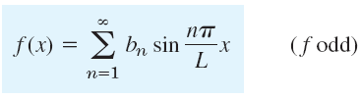

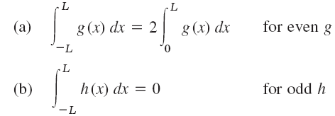
Note

Slide 20
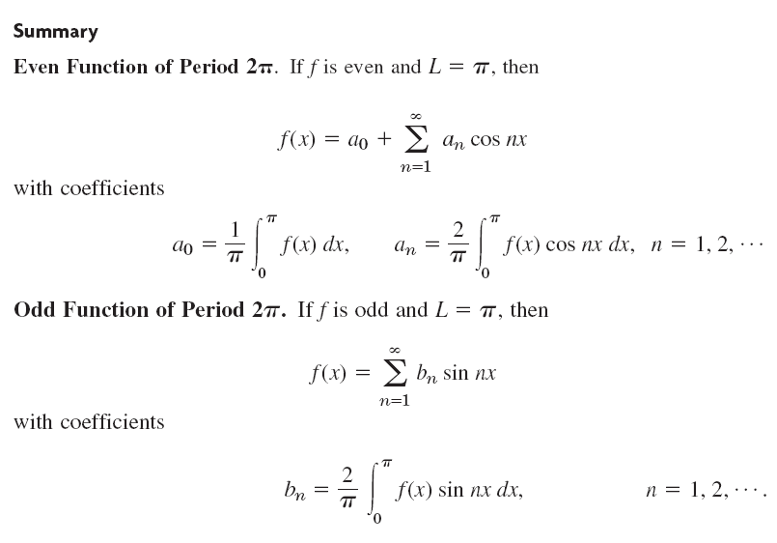

Slide 21
Fourier Integral

Slide 22
Fourier series are powerful tools for problems involving functions that are periodic or are of interest on a finite interval only.
Since, of course, many problems involve functions that are
non-periodic and are of interest on the whole x-axis, we ask what can be done to extend the
method of Fourier series to such functions. This idea will lead to “Fourier integrals.”

Slide 23
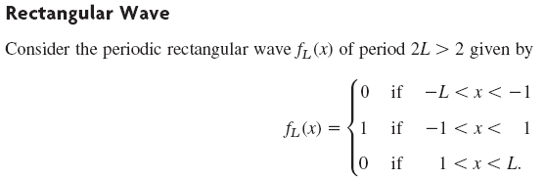

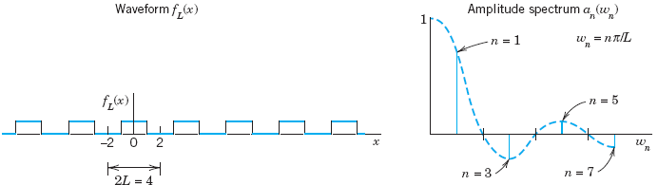

Slide 24
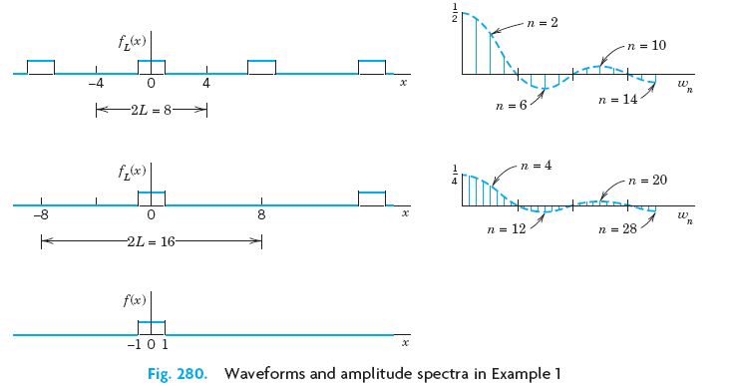

Slide 25





Fourier Series:
Fourier Integral:

Slide 26
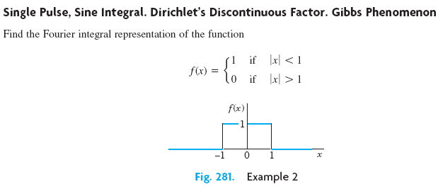

Slide 27
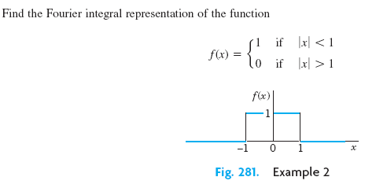
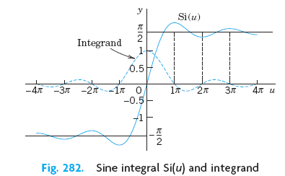

Slide 28





Slide 29
An integral transform is a transformation in the form of an integral that produces from given functions new functions depending on a different variable.
Fourier transforms. can be obtained from the
Fourier integral.

Slide 30
Fourier Cosine Transform
The Fourier cosine transform concerns even functions f(x). We obtain it from the Fourier cosine integral

